Slide 1
Musicalgorithms 3.0
Anthony Della Maggiora
Dylan Paulus
Michelet Chery
Kristi Marks

Slide 2
Overview
Project Description
Previous version problems
Technologies Used
Features
Obstacles
Future Features
Skills Learned

Slide 3
Description of Project
Translate Musicalgorithms 2.0 to HTML5
  Turn data into music using simple algorithms
  Generate data for common mathematical symbols using sequence algorithms (ex. PI, Phi, E, etc.)
  Allow user to enter custom data sequences
Easy to use
Morphing Algorithm
Multiple voice support

Slide 4
Musicalgorithms 2.0
Problems:
  Usability
  Slow
  Unfriendly Pop-up Warnings
  Redundant/Unnecessary Buttons
  Crashing issues

Slide 5
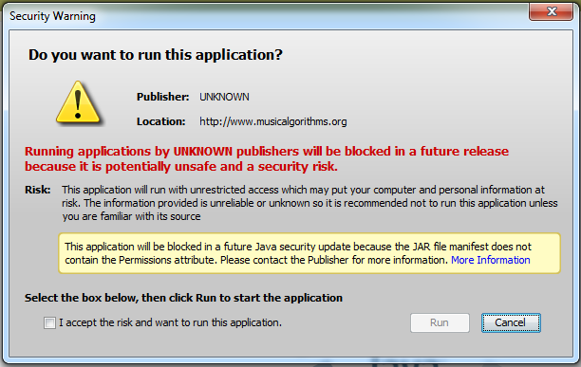
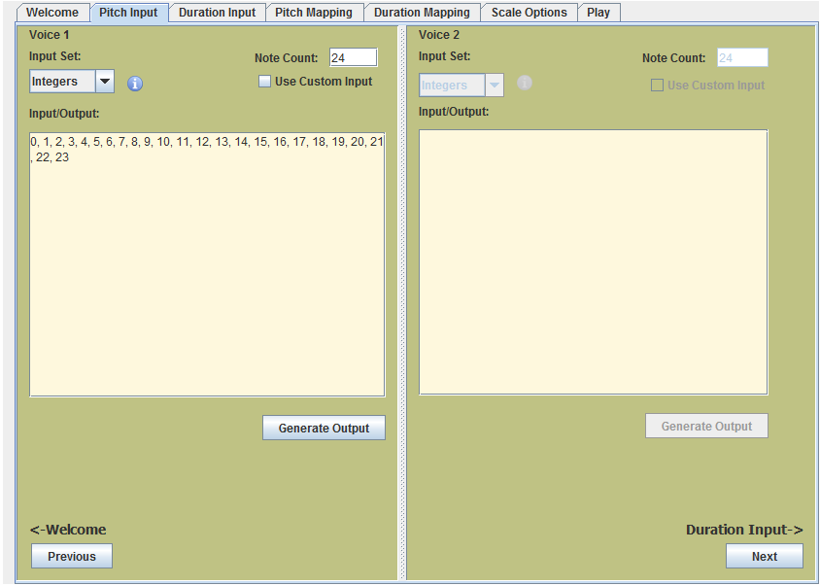
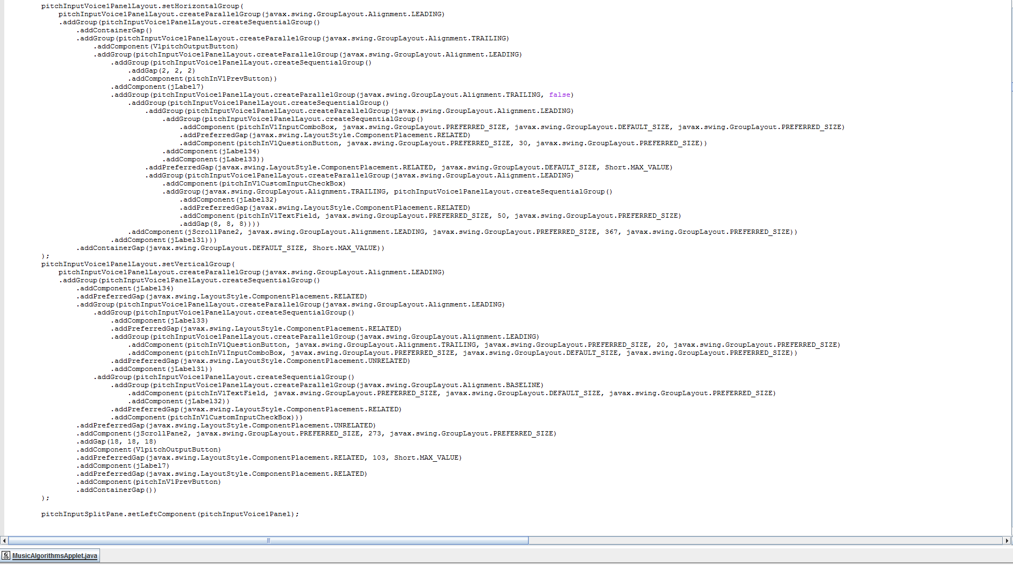

Slide 6



Technologies Used
HTML5
JQuery/Javascript
SASS
Bootstrap
PHP

Slide 7
HTML5, JQuery, Javascript
Improves Cross-platform usability
User friendly
Faster
Runs on local machine
Easy to learn
Scalable

Slide 8
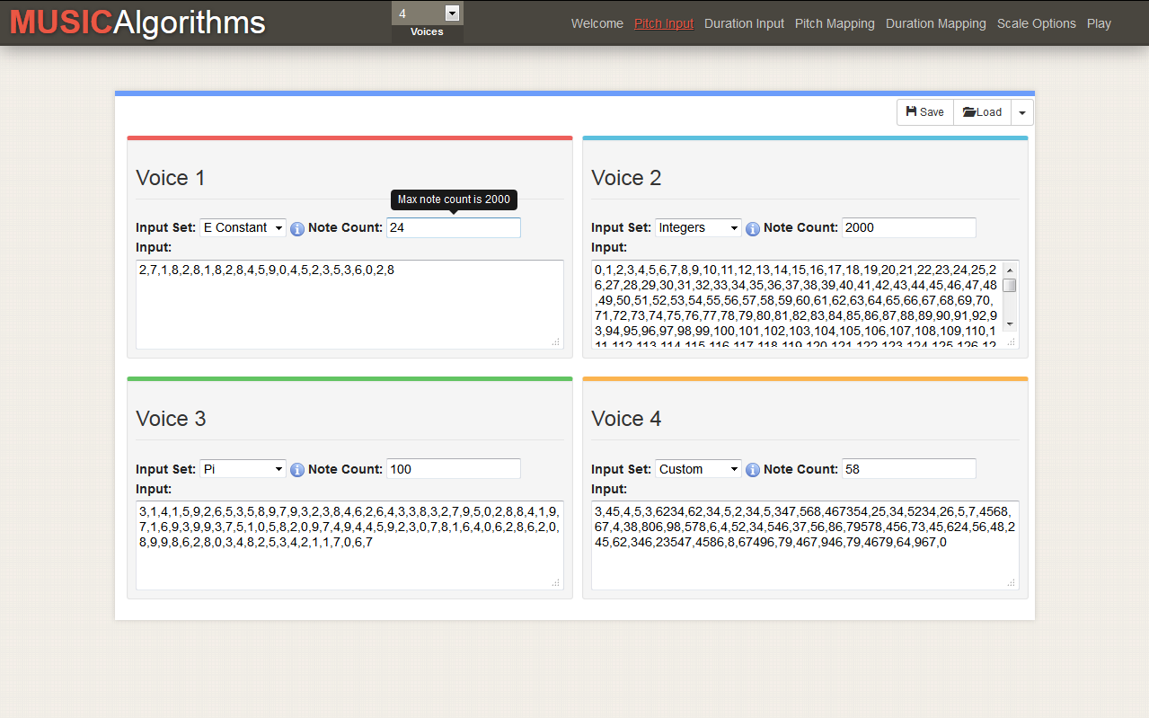
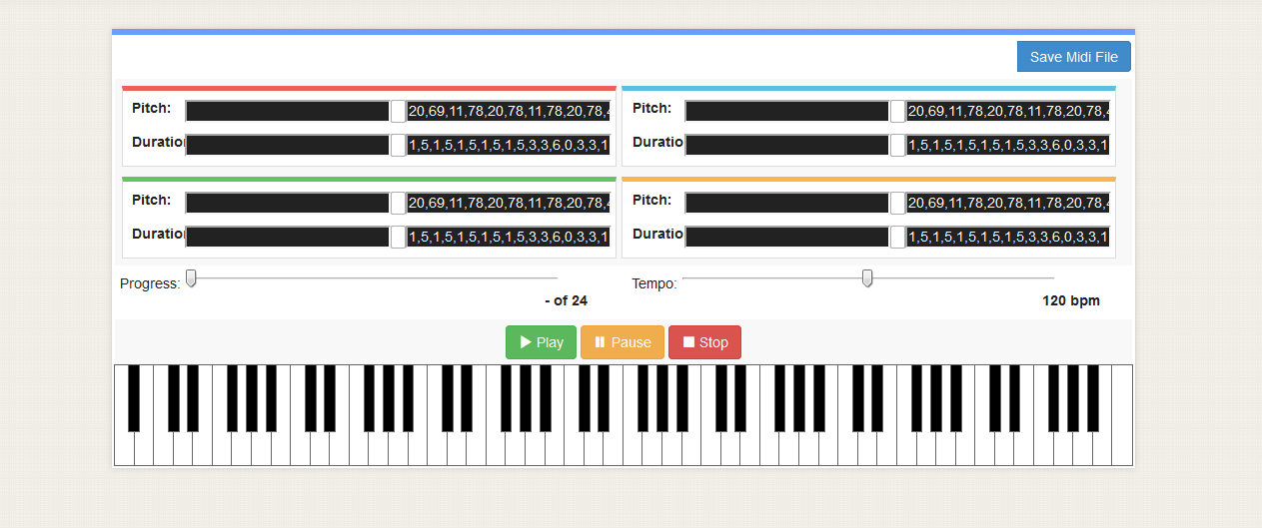

Slide 9

Process
Step 1: Learn HTML5/Javascript/JQuery/etc.
Step 2: Create Outline
Step 3: Add functionality
Step 4: Refine
Repeat Steps 3 & 4 as necessary

Slide 10
Layout
Animations
Better flow
More concise
SASS
Bootstrap

Slide 11
Algorithms
Factory design pattern
Strategy design pattern
Spigot
Calculations
Generates more
Morphing Algorithm

Slide 12
Piano
MIDI file formats
PHP
Multi-voice design
MIDI.js

Slide 13
Features
Morphing algorithm
Pregenerated and custom inputs
Multiple voice support
Easy to use UI
Faster and more optimized

Slide 14
Obstacles
MIDI
Little web experience
Hard to read source code

Slide 15
Future Features
Improved login page with benefits
Implement testing standards
Ability to replace notes
More instruments

Slide 16
Skills Learned
Javascript
JQuery
HTML5
Bootstrap
CSS
PHP

Slide 17
Questions?

